Slide 1
Ch-06 AI painter

Slide 2
What is an Interactive GAN (iGAN)?
An Interactive GAN (iGAN) is an extension of the traditional GAN architecture that allows users to control the generation process interactively. It enables users to manipulate the generated outputs in real-time by providing semantic inputs.

Slide 3
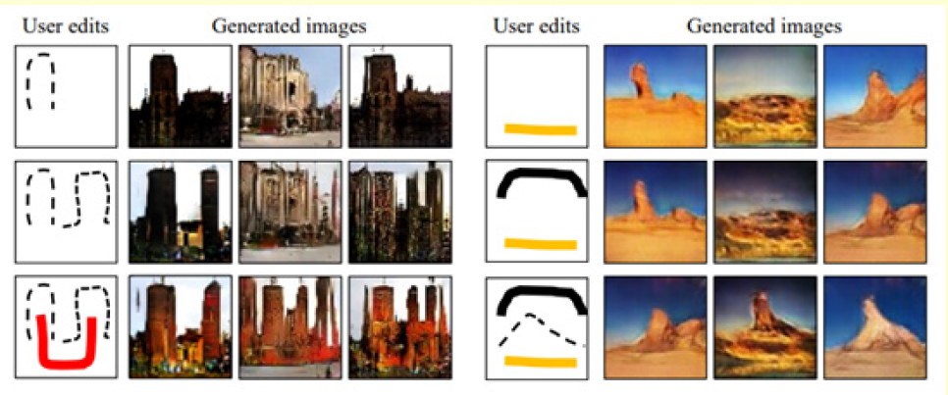
Key Characteristics
Interactive image editing: A picture is imported and we perform image editing using a GAN. Early GANs generated images uses only noise as input.
Even BicycleGAN (which was invented a few years after the iGAN) could only change the appearance
of generated images randomly without direct manipulation.
iGANs allow us to specify changes in color and texture, which is impressive.

Slide 4
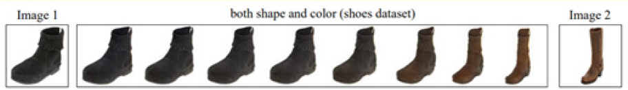
Key Characteristics..
Interactive image transformation (morphing): Given two images, an iGAN can create sequences of images that show a morphing

Slide 5
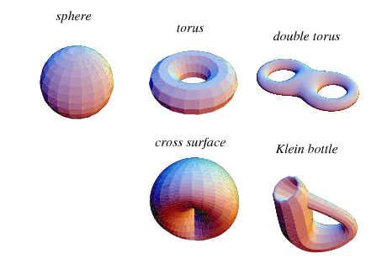
What is a Manifold?
Manifolds exist in any dimension, but for the sake of simplicity, let’s think about a three-dimensional space.
Suppose there is a small ant walking along a manifold in three dimensions. This manifold could be curvy, twisty, or even have holes in it. Now here’s the rule: From the point of view of the ant, everywhere it walks should look like a flat plane.

Slide 6
Can you think of surfaces that are not manifolds? These surfaces will have problems at some “sharp” points. Below are the first few that come to mind for me:
A cube. If you walk along a side and get to an edge, things will be too sharp and will no longer look like a plane.
The landscape of a mountain. Assuming that the peak is perfectly sharp, at this point things will not look like a plane.

Slide 7
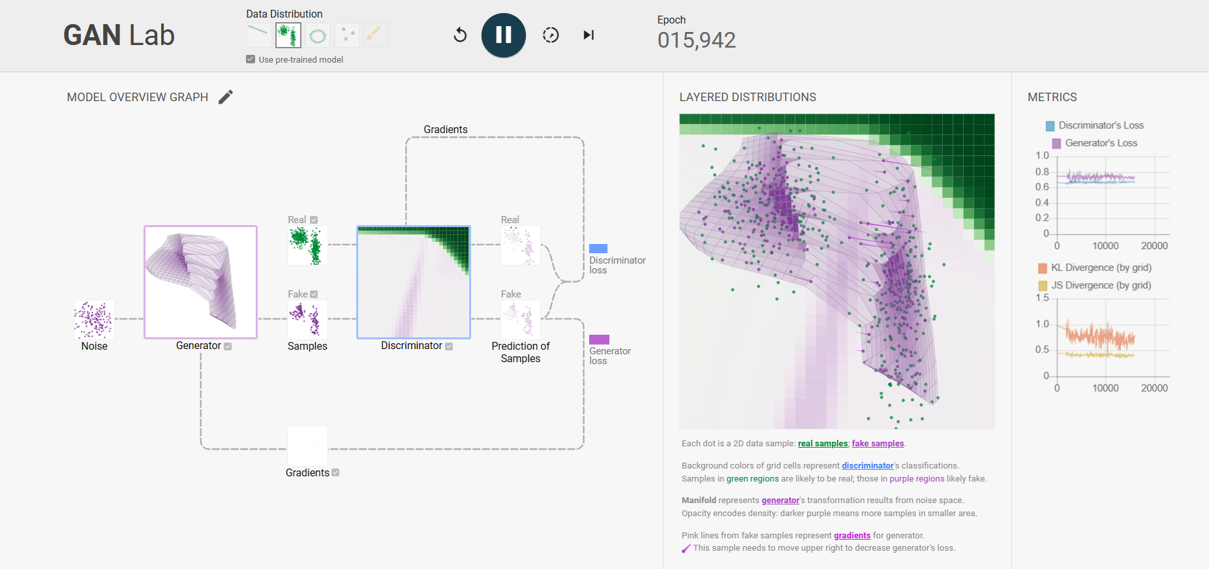
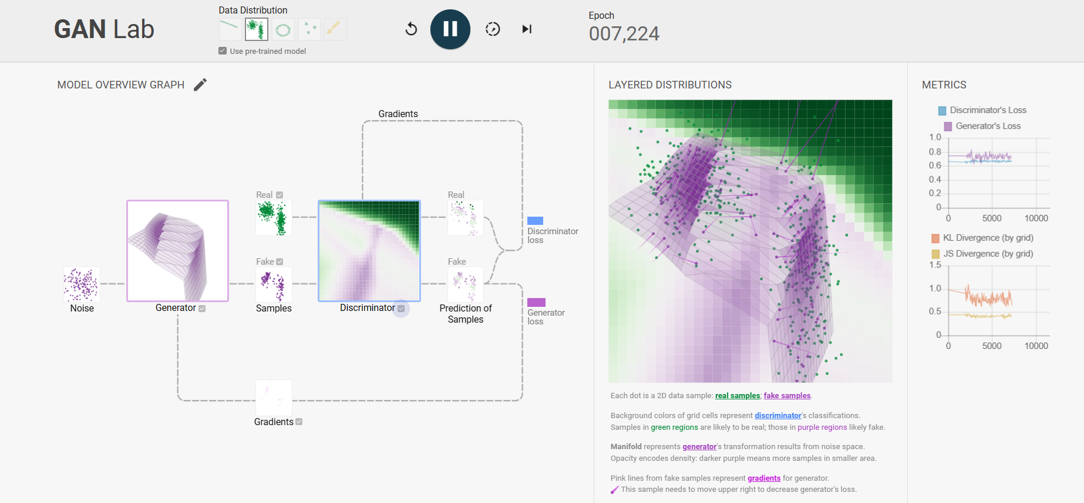
A good resource to visualize manifolds in GAN
GAN Lab: Play with Generative Adversarial Networks in Your Browser! (poloclub.github.io)

Slide 8
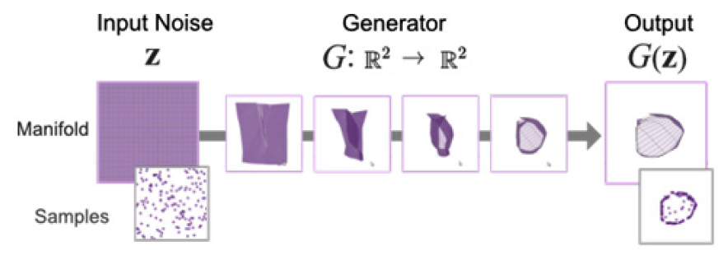
GAN is trained to map uniformly distributed 2D samples into 2D samples that have a circular distribution

Slide 9
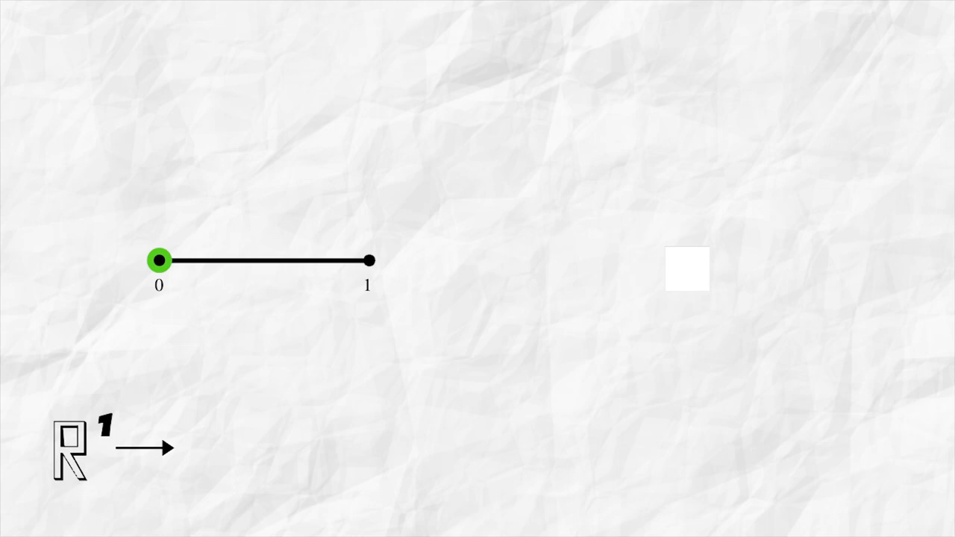
Understanding manifold

Slide 10
Projecting an image onto a manifold
we will use a pre-trained DCGAN where the input to the generator is a 100-dimension latent vector. Therefore, we will need to find a latent vector that generates an image manifold that is as close as possible to the original image. One way to do this is to use optimization such as style transfer, a topic we covered in detail in Chapter 5, Style Transfer.
1. We first extract the features of the original image using a pretrained convolutional neural network (CNN), such as the output of the block5_conv1 layer in VGG (see Chapter 5, Style Transfer), and use it as a target.
2. Then, we use the pre-trained DCGAN's generator with frozen weights and optimize on the input latent vector by minimizing the L2 loss between the features.
Another method is to train a feedforward network to predict the latent vector from the image, which is a lot faster. If the GAN is to translate a segmentation mask into an image, then we can use a network such as U-Net to predict the segmentation mask from the image.

Slide 11
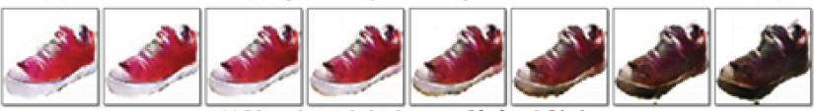
Editing the manifold using latent vector
Now that we have obtained the latent variable z and the image manifold x = G(z ), the next step is to manipulate z to modify the image.
let's say the image is a red shoe and we want to change the color to black
The simplest and crudest method is to open an image editing software package to select all the red pixels in the picture and change them to black. The resulting picture is likely to not look very natural as some details may be lost. Traditional image editing tools' algorithms tend to not work that well on natural images with complex shapes and fine texture details.

Slide 12
Editing the manifold..
On the other hand, we know we probably could change the latent vector and feed that to the generator and change the color. In practice, we do not know how to modify the latent variables to get the results we want.
Therefore, instead of changing the latent vector directly, we could attack the problem from a different direction. We can edit the manifold, for example, by drawing a black stripe on the shoes, then use that to optimize the latent variables, and then project that to generate another image on the manifold.

Slide 13
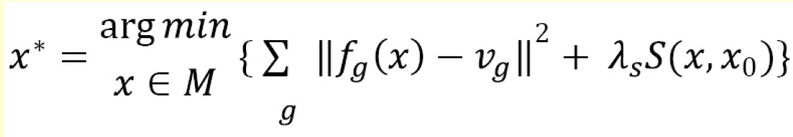
Essentially, we are performing optimization as previously described for manifold projection but with different loss functions. We
want to find an image manifold x that minimizes the following equation:
Feature Matching: Match the feature vector extracted from user input with the feature vector of generated images using techniques like nearest neighbor search or similarity metrics.

Slide 14
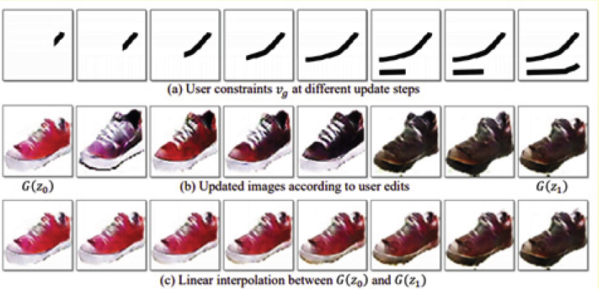

Slide 15
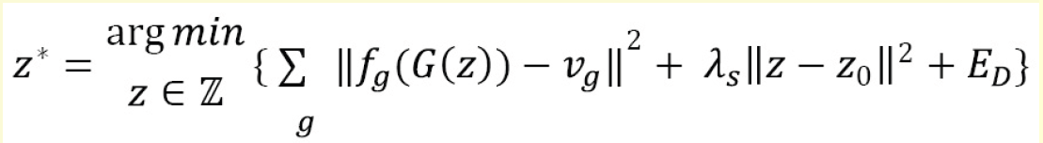
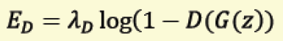
The last term is the GAN's adversarial loss. This is used for making the manifold look real and improve the visual quality slightly.

Slide 16
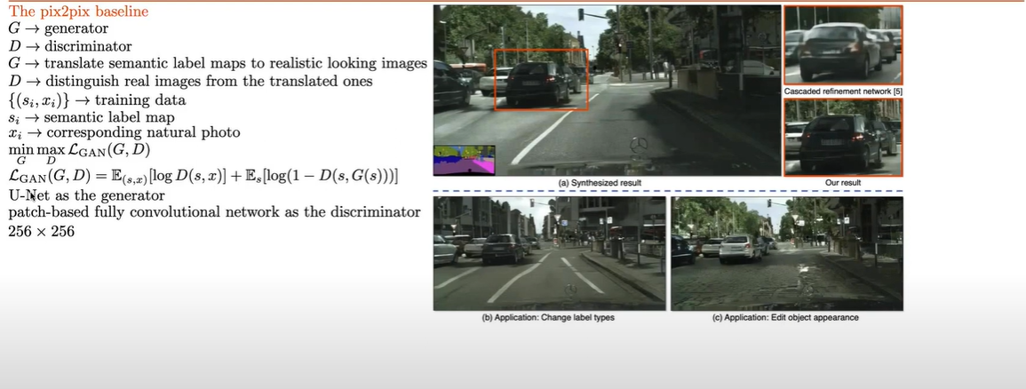
Pix2pixHD Vs Pix2pix

Slide 17
Pix2pixHD
pix2pixHD is an upgraded version of pix2pix that can generate high-definition (HD) images.
In order to generate high-resolution images, pix2pixHD uses two generators at different image resolutions at coarse- and fine-scale.
The coarse generator G1 works at half the image resolution; that is, the input and target images are downsampled into half the resolution.
the fine generator G2, which works on the full-image scale.

Slide 18
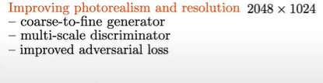
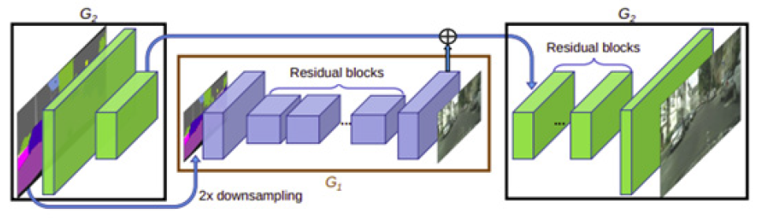
Pix2pixHD
we can see that G 's encoder output concatenates with G 's features and feeds into the decoder part of G to generate high-resolution images. This setting is also known as a coarse-to-fine generator.
pix2pixHD uses three PatchGAN discriminators that operate at different image scales. A new loss, known as feature matching loss, is used to match the layer features between the real and fake images.

Slide 19
Spatially-Adaptive Normalization
SPADE, or Spatially-Adaptive Normalization is a conditional normalization method for semantic image synthesis. Similar to Batch Normalization, the activation is normalized in the channel-wise manner and then modulated with learned scale and bias.
In the SPADE, the mask is first projected onto an embedding space and then convolved to produce the modulation parameters γ and β
SPADE try to remove the art effects in Pix2PixHD

Slide 20
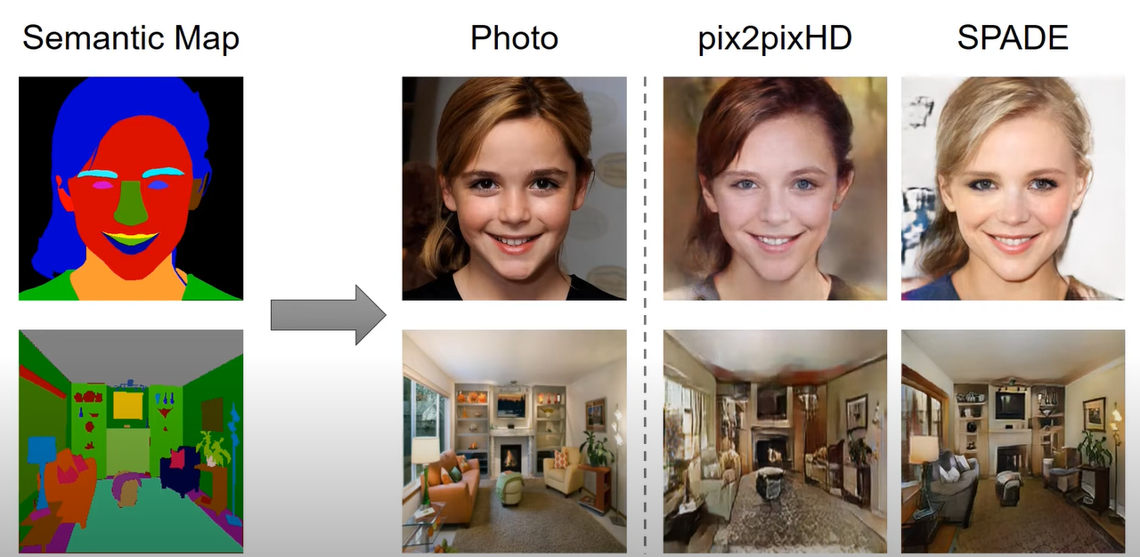

Slide 21
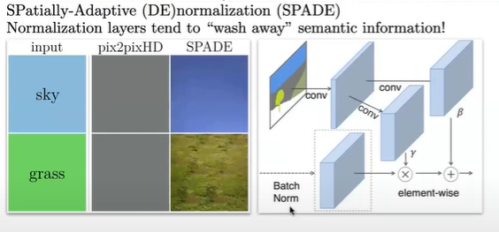
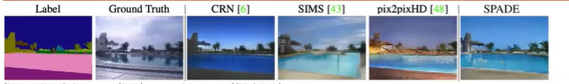
The Problem
Modify your batch norm

Slide 22
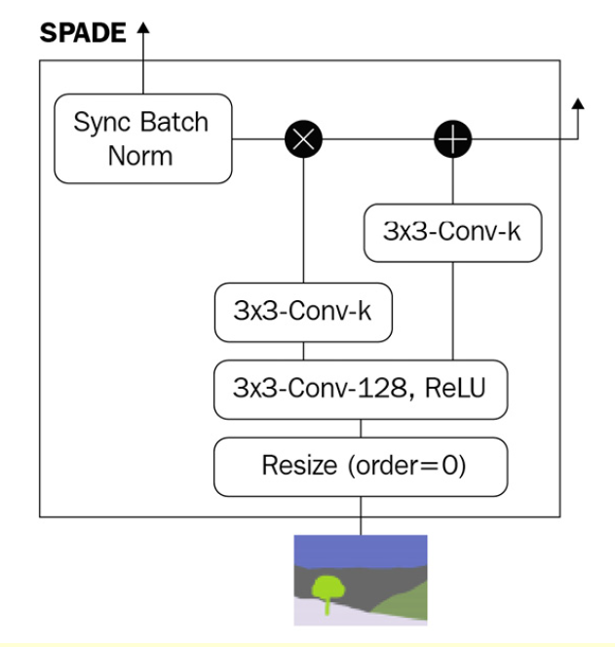
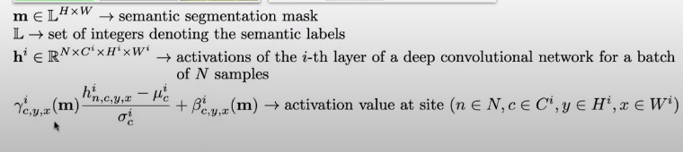
The Idea

Slide 23
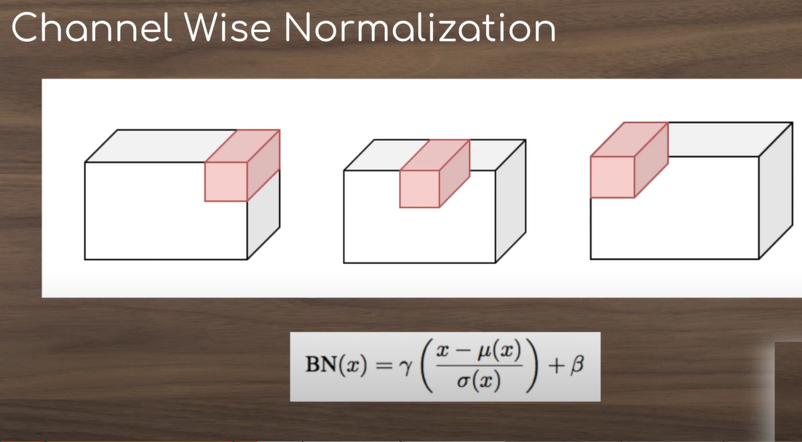

Slide 24
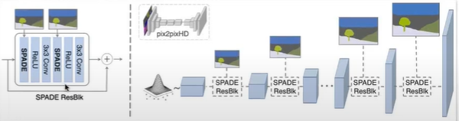
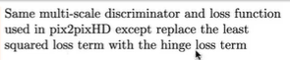

Slide 25
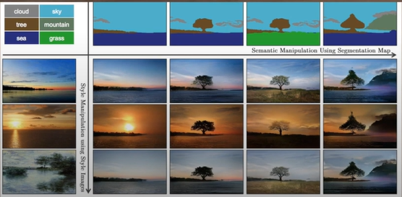
GauGAN
is a GAN from Nvidia , named after the famous artist Paul Gauguin ,is an interactive AI model that allows users to create photorealistic images from simple sketches.

Slide 26
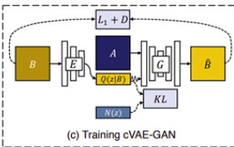
Building the GauGAN generator
In pix2pix, the generator takes in only one input – the semantic segmentation map. As there is no randomness in the network
One of the two methods used by BicycleGAN (Chapter 4, Image-to-Image Translation) to address this problem is using an encoder to encode the target image (the real photo) into latent vectors, which are then used to sample random noise for the generator input.
This cVAE-GAN structure is used in the GauGAN generator.

Slide 27
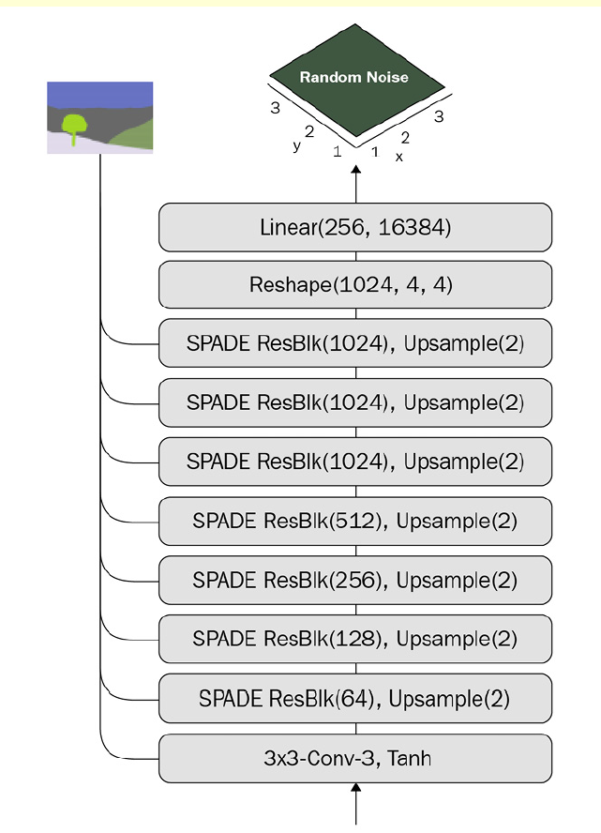

Slide 28
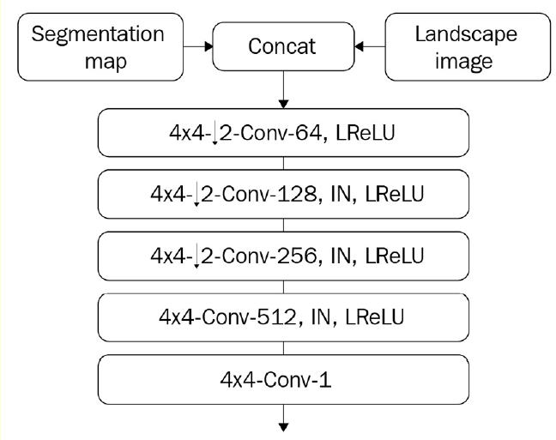
Building the discriminator
The discriminator is PatchGAN, where the input is a concatenation of the segmentation map and the generated image.
we will use the RGB segmentation map instead of a one-hot encoded segmentation mask

Slide 29
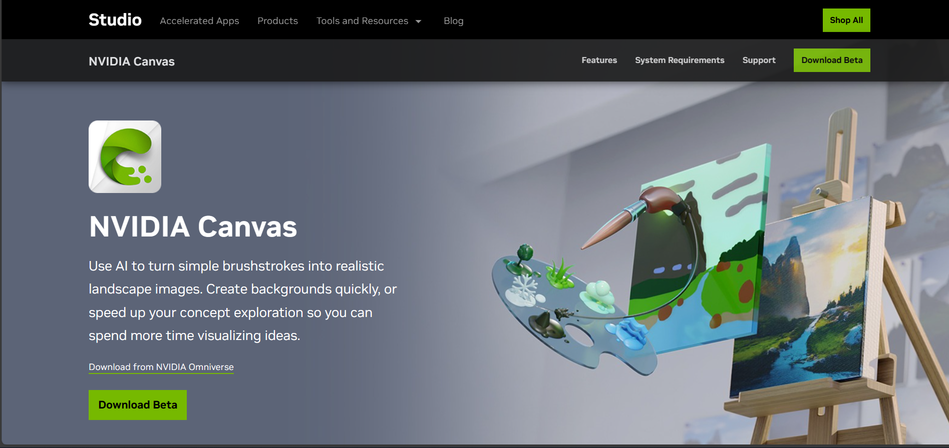
Creating Artistic Images with NVIDIA GauGAN

Slide 30
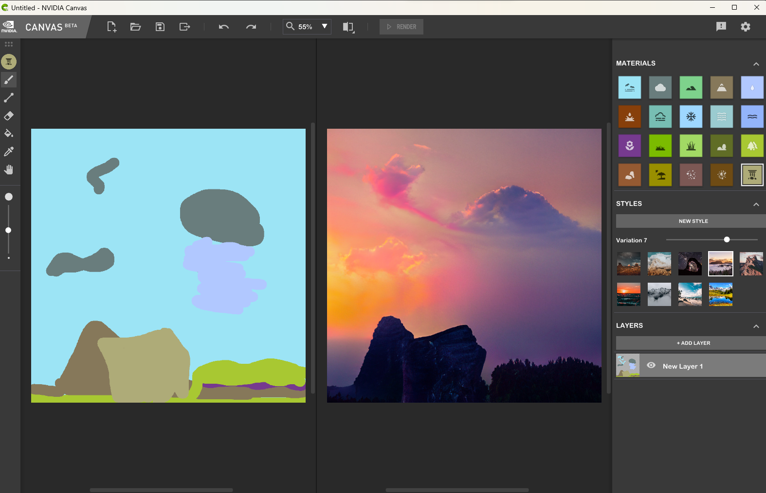

Slide 31
Feature matching loss
Feature matching loss has been successfully used in style transfer. The content and style features are extracted using a pre-trained VGG and the losses are calculated between the target image and the generated image.
The content features are simply the outputs from multiple convolutional blocks in VGG. GauGAN employs content loss to replace L1 reconstruction loss, which was common among GANs.
The reason is that reconstruction loss makes comparisons pixel by pixel, and the loss can be large if the image shifts in location despite still looking the same to human eyes.
On the other hand, the content features of convolutional layers are spatially invariant. As a result, when using the content loss to train on the facades dataset, our generated buildings will look a lot less blurry and the lines will look straighter.
The content loss in style transfer literature is sometimes known as VGG loss in code, as people love to use VGG for feature extraction.

Slide 32
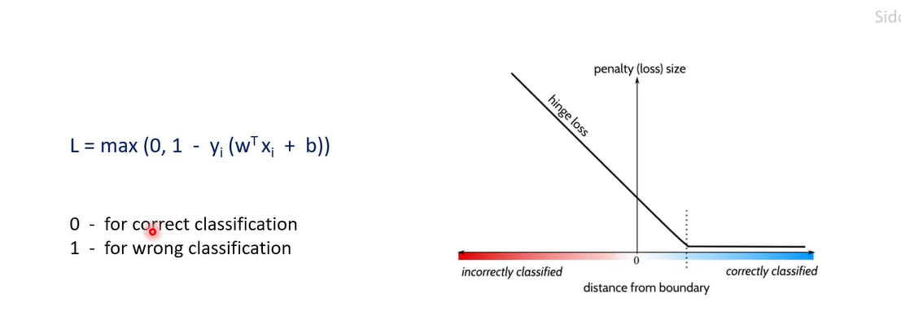
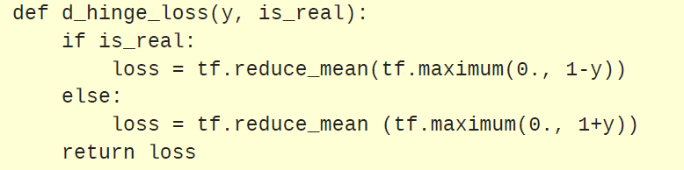
Hinge loss
Hinge loss may be a newcomer in the GAN world, but it has long been used in support vector machines (SVMs) for classification. It maximizes the margin of the decision boundary

